Slide 1
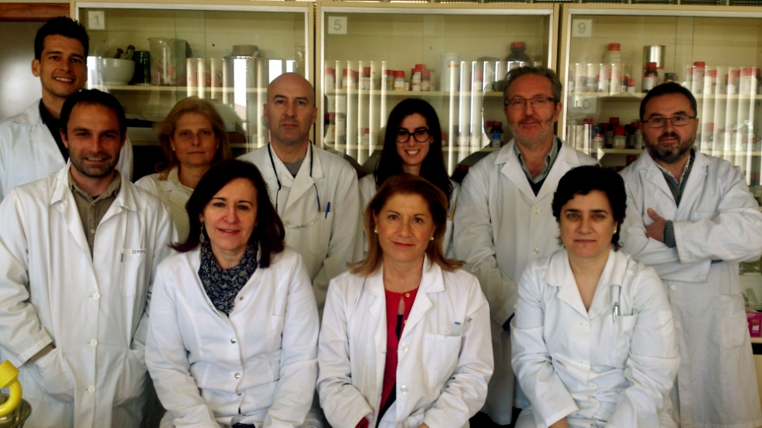
1
2. Oncología Clínica Experimental. Biología celular.
GI/IMIB/E110/2011-METALOFÁMACOS ANTITUMORALES NO CONVENCIONALES
Prometallodrugs Development.
Drug delivery systems like nanoparticles for tumor-specific accumulation and activation of anticancer drugs.
Drug targeting strategies using tumor-specific peptides.

Slide 2
1
2. Oncología Clínica Experimental. Biología celular.
GI/IMIB/E110/2011-METALOFÁMACOS ANTITUMORALES NO CONVENCIONALES
COST ACTION CM1105
CTQ2015-64319-R
METALOFARMACOS PARA EL TRATAMIENTO DEL CANCER Y ESTRATEGIAS PARA SU VEHICULIZACION CELULAR
CTQ2015-70371-REDT
- NETWORK
Metals in Therapy and Diagnosis

Slide 3
1
2. Oncología Clínica Experimental. Biología celular.
GI/IMIB/E110/2011-METALOFÁMACOS ANTITUMORALES NO CONVENCIONALES
Zamora A, Pérez SA, Rodríguez V, Janiak C, Yellol GS, Ruiz J. Dual antitumor and antiangiogenic activity of organoplatinum(II) complexes. J Med Chem. 2015 Feb 12;58(3):1320-36. IF: 5.447.
Yellol J, Pérez SA, Buceta A, Yellol G, Donaire A, Szumlas P, Bednarski PJ, Makhloufi G, Janiak C, Espinosa A, Ruiz J. Novel C,N-Cyclometalated Benzimidazole Ruthenium(II) and Iridium(III) Complexes as Antitumor and Antiangiogenic Agents: A Structure-Activity Relationship Study. J Med Chem. 2015 Sep 24;58(18):7310-27. IF: 5.447.
Lozano-Pérez AA, Gil AL, Pérez SA, Cutillas N, Meyer H, Pedreño M, D Aznar-Cervantes S, Janiak C, Cenis JL, Ruiz J. Antitumor properties of platinum(iv) prodrug-loaded silk fibroin nanoparticles. Dalton Trans. 2015 Mar 23. IF: 4.197.

