Slide 1
7. BIOTECNOLOGÍA. APLICACIONES SANITARIAS DE BIOCIENCIAS
1. TECNOLOGÍA Y PATOLOGÍA DE LA REPRODUCCIÓN
GI/IMIB/C072/2011. Fisiología Reproductiva y Reproducción Asistida
Generación de cerdos transgénicos que sirvan de biomodelos de enfermedad
Reproducción y transmisión de enfermedad

Slide 2
7. BIOTECNOLOGÍA. APLICACIONES SANITARIAS DE BIOCIENCIAS
1. TECNOLOGÍA Y PATOLOGÍA DE LA REPRODUCCIÓN
GI/IMIB/C072/2011. Fisiología Reproductiva y Reproducción Asistida
Generation of knockout pigs with loss of TPC2 endolysomal calcium channel
Royal Society. International Exchanges Scheme 2014/R1 Ref: IE140324.
UK Scientist: Dr. John Parrington. University of Oxford. UK.
Overseas Scientist: Dr Joaquin Gadea. University of Murcia. Spain.
Award Value: £11.960
Start Date: 31/03/2015 End Date: 30/03/2017

Slide 3
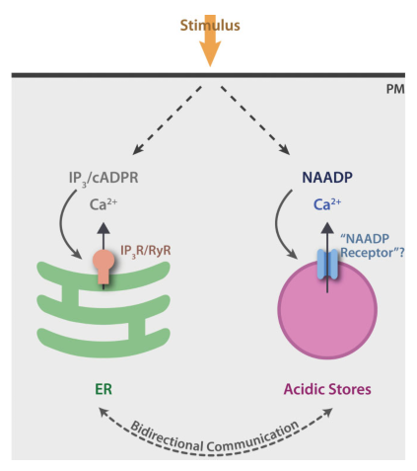
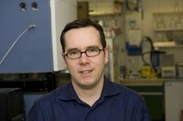
Ca⁺⁺ mobilising second messengers
Inositol 1,4,5-trisphosphate (IP3)
cyclic ADP-ribose (cADPR)
NAADP
Dr. John Parrington
Morgan & Galione, BioEssays 2014

Slide 4
Brown adipose tissue
Skeletal muscle autophagic signaling.
Pancreatic β Cells
Autophagy in cardiomyocytes
Signalling in the Heart
Others activities??
T-cells
TPC KO Mice
Notes:
Schematic diagram depicts partial family trees from the animal kingdom and identifies key examples of species in which the genes encoding TPC1, TPC2, and TPC3 are absent or present. “>” denotes possible presence of additional TPCs.

Slide 5
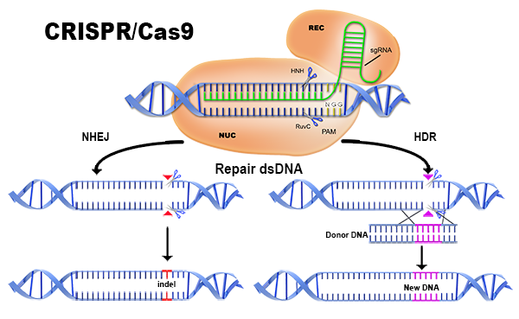
Generation of knockout pigs with loss of TPC2

Slide 6
Brown adipose tissue?
Skeletal muscle autophagic signaling?
Pancreatic β Cells?
Autophagy in cardiomyocytes?
Signalling in the Heart?
Others activities??
T-cells?
TPC KO Pig
Notes:
Schematic diagram depicts partial family trees from the animal kingdom and identifies key examples of species in which the genes encoding TPC1, TPC2, and TPC3 are absent or present. “>” denotes possible presence of additional TPCs.

Slide 7
7. BIOTECNOLOGÍA. APLICACIONES SANITARIAS DE BIOCIENCIAS
1. TECNOLOGÍA Y PATOLOGÍA DE LA REPRODUCCIÓN
GI/IMIB/C072/2011. Fisiología Reproductiva y Reproducción Asistida
ARREDOUANI et al. NAADP and endolysosomal two-pore channels modulate membrane excitability and stimulus-secretion coupling in mouse pancreatic β cells. J Biol Chem 2015; 290:21376-21392.
GÓMEZ-MARTÍN et al. Survival capacity of Mycoplasma agalactiae and Mycoplasma mycoides subsp. capri in the diluted semen of goat bucks and their effects on sperm quality. Theriogenology. 2015. 83. 919-919. doi: 10.1016/j.theriogenology.2014.11.029.

Slide 8
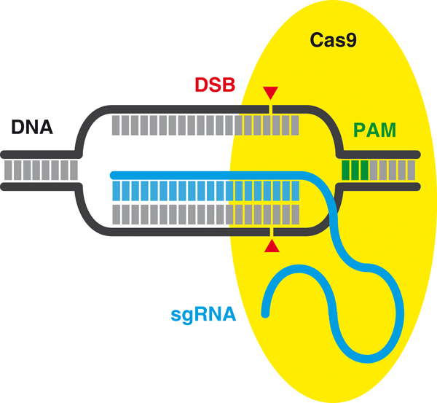
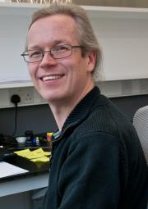
Pig TPC2 CRISPR targeting
Design of guides
JP_pTPC2_1 | ACGCCGGGTGTAGCCGCCTGCGG
JP_pTPC2_2 | CTACACCCGGCGTGCAGTAGCGG
JP_pTPC2_3 | CCTGGATGGCGTCTTCGATGAGG
JP_pTPC2_4 | CCTCATCGAAGACGCCATCCAGG
JP_pTPC2_5 | GGTGATTAATGGAGCGGTACTGG
JP_pTPC2_6 | TTAATCACCGCATGGACGCCCGG
Dr. Andrew Bassett
Genome Engineering Oxford (GEO)

Slide 9
Pig TPC2 CRISPR targeting
The guides were cloned into plentiCRISPRv2
transfected into in vitro cultured pig cells, followed by puromycin selection
Immortalised pig mesenchymal stem cell line

Slide 10
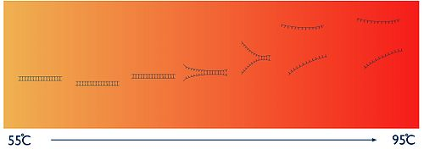
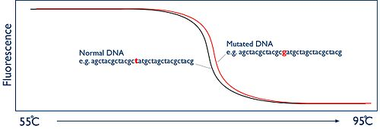
Pig TPC2 CRISPR targeting
DNA extraction
High-resolution melting analysis (HRMA)
Sequencing

Slide 11
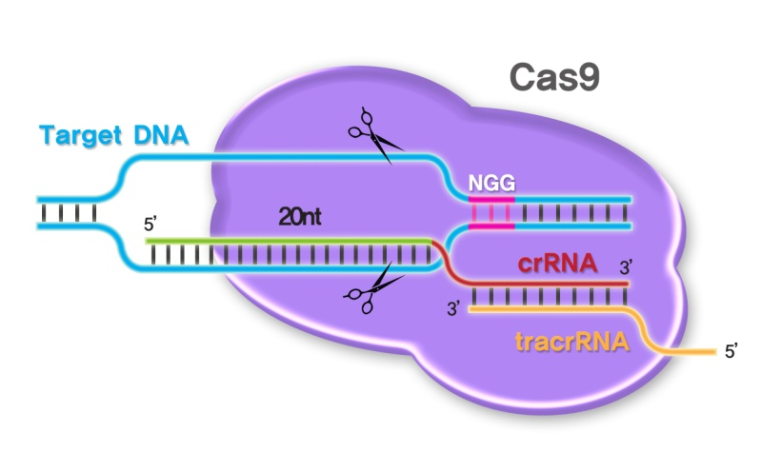
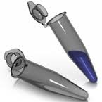
Embryo recovery
Embryo injection
Embryo culture/transfer

Slide 12
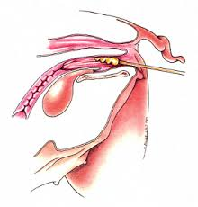
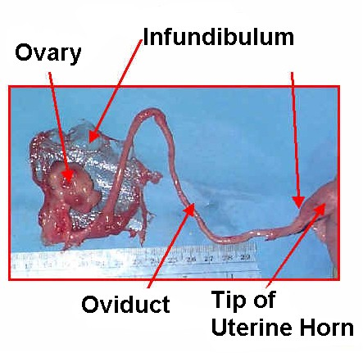
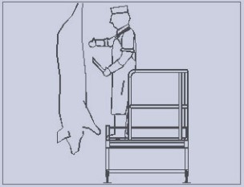
Oestrus detection in sows
Artificial insemination
CARNICAS
CIEZANAS SA
Sow slaughtering

Slide 13
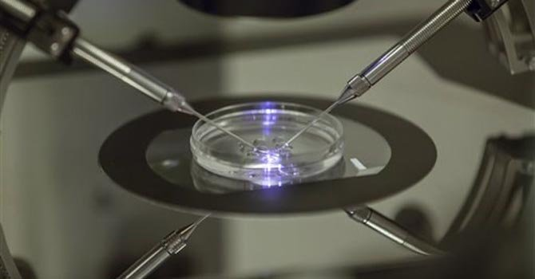
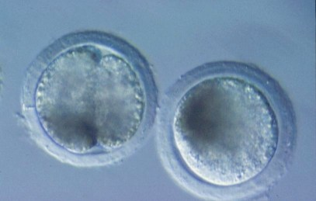
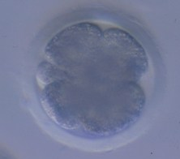
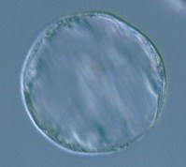
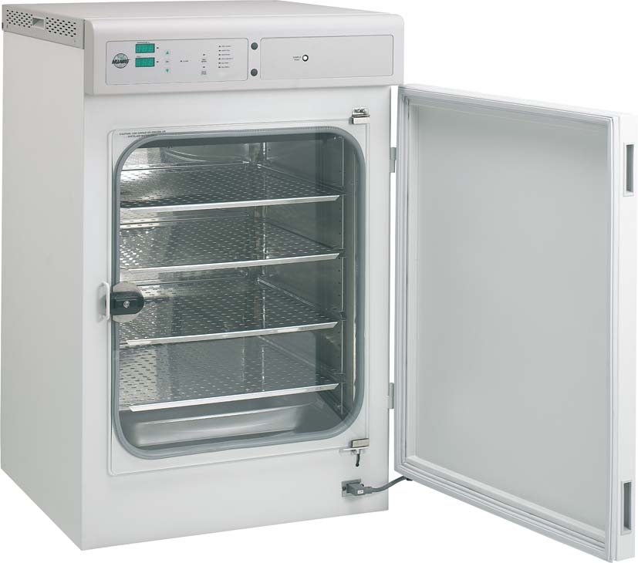
Oviductal flushing
Embryo selection
Embryo injection
Embryo culture
Embryo evaluation

Slide 14
sgRNA injection to porcine zygotes
JP_pTPC2_5 | GGTGATTAATGGAGCGGTACTGG
4/15 (26.7%)
3/6 (50%)
3/7 (42.8 %)
3 batches

Slide 15
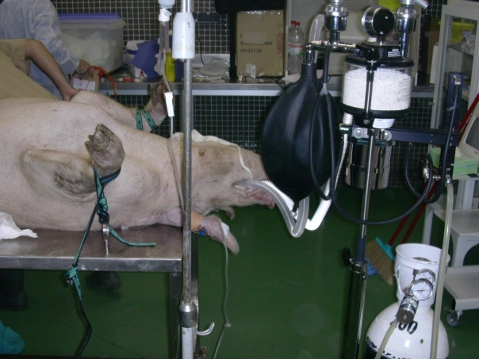
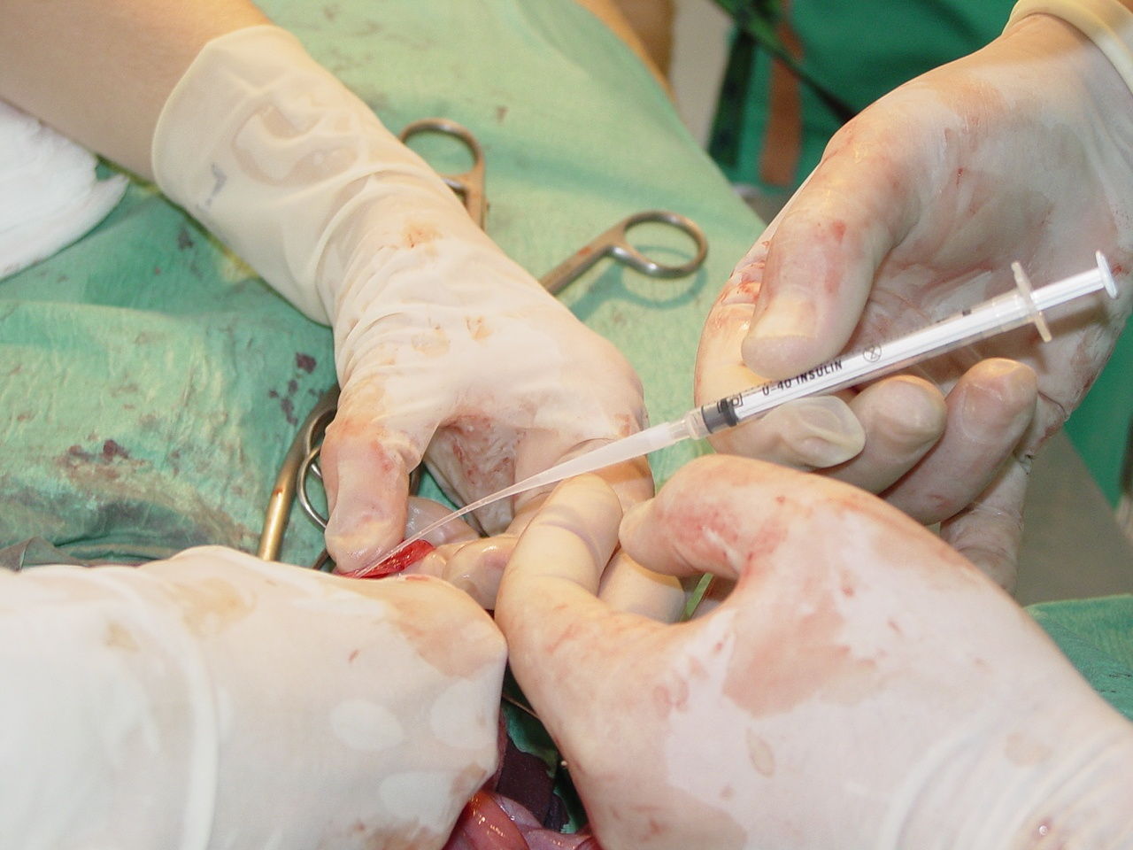
Ready for embryo transfer to recipients?
Notes:
15
15

Slide 16
Legal and Ethical Issues of Genetic Engineering Pigs (Risk I)
Comisión Nacional de Bioseguridad (CNB)
Technical Issues to solve
Best embryo injection conditions
In vivo vs. in vitro produced embryos
Embryo culture before transferring?
Number of embryos to transfer?

Slide 17
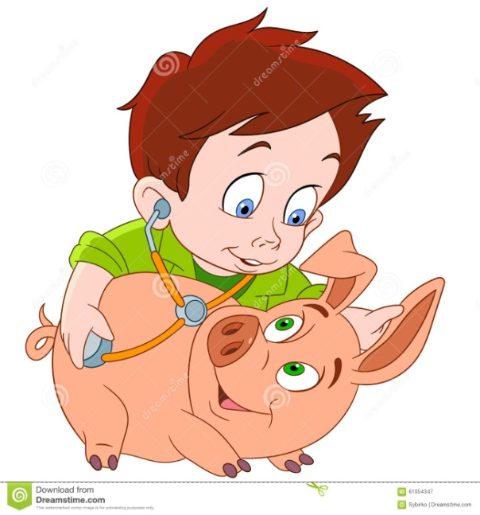
Next steps
Get piglets after embryo transfer
Resulting offspring will be genotyped
Phenotypic study KO vs. WT piglets
Heart function, metabolism and immune function

Slide 18
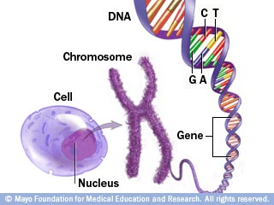
Ready for generation of new PIG models of interest?
Specific mutations in TPC2 modelled on those recently identified in human patients with neurological defects
Other genes related to NAADP and ARC (TPC1, CD38, CD157)
Calcium signalling and reproduction (PLCzeta)
Other genes of interest??

Slide 19
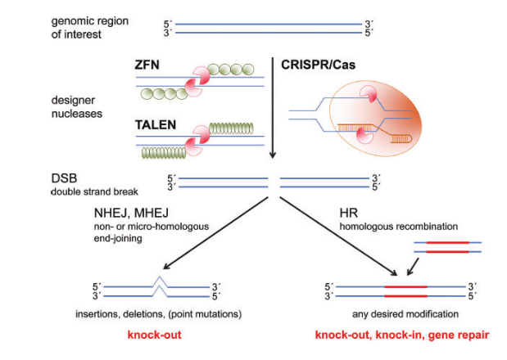
Ready for exploring other methodologies or models ? KO, KI, conditional KO, KI, etc…

Slide 20
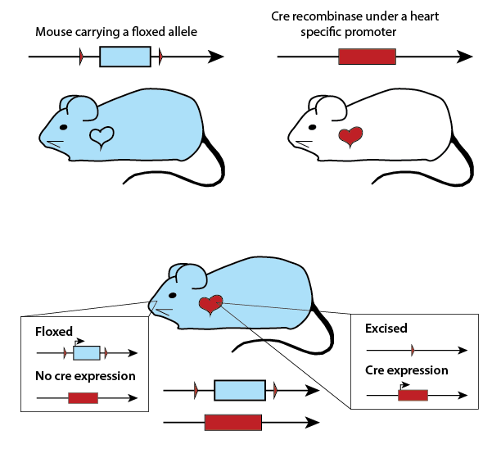
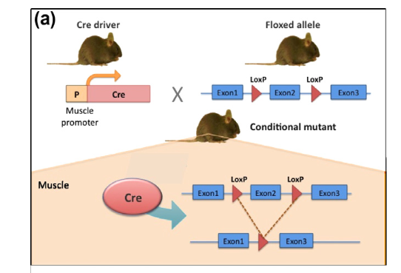
Conditional mutation
System Cre recombinase - Floxed alleles (LoxP)
By crossing floxed strains with those expressing Cre from a specific promoter, we will create cell-type specific Kos
Smedley et al, 2011

Slide 21
Conditional Kos
System Cre recombinase - Floxed alleles (IoxP)
By inducted mutation. Injection of Adenovirus Cre
Schook et al. 2016

